Slide 1
𝚂𝚙𝚞𝚝𝚗𝚒𝚔 𝟷

Slide 2
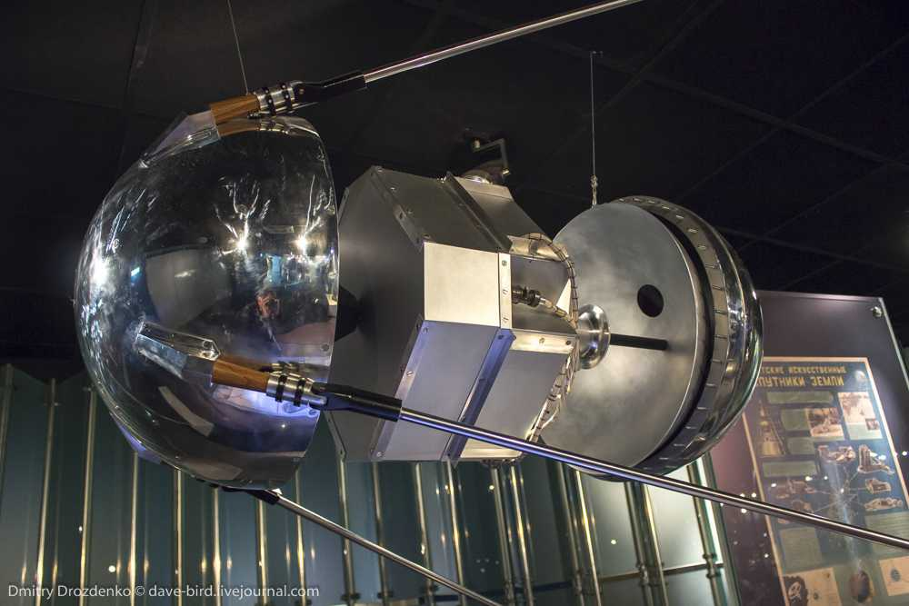
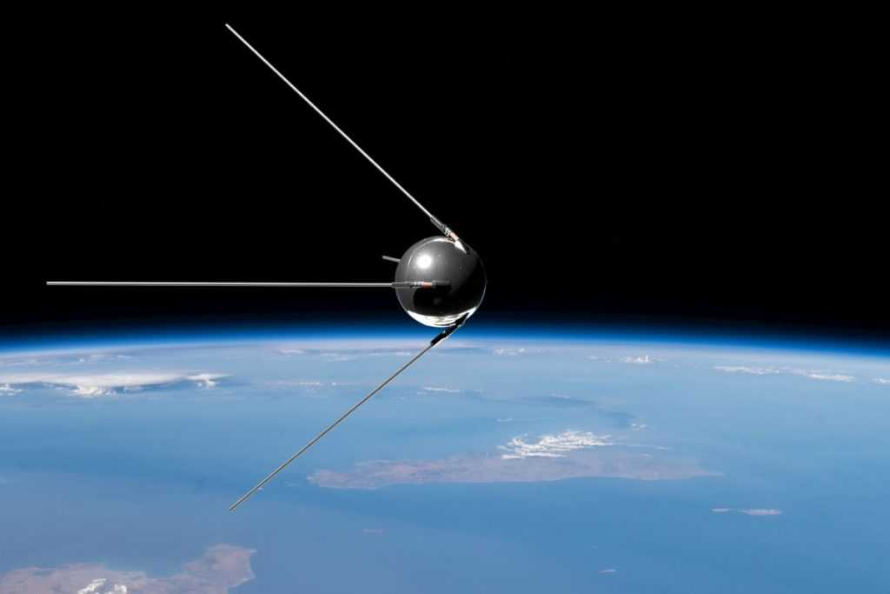
some pictures

Slide 3
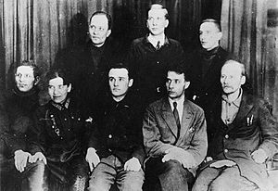
who worked on the satellite
Korolev, Keldysh, Tikhonravov, Ryazansky, Ivanovsky, Lidorenko, Maksimov, Lappo, Gringauz, Chekunov, Bukhtiyarov, Bereskov and others worked on the first satellite of the USSR.

Slide 4
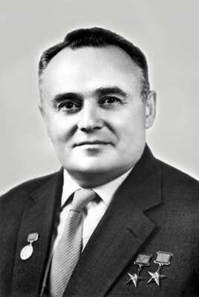
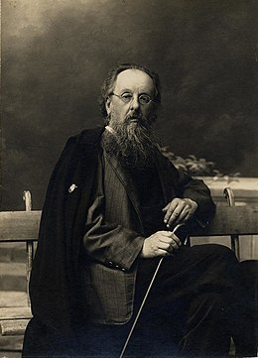
How was the satellite created?
The flight of the first satellite was preceded by a long work of many scientists and designers. The theory of jet propulsion was one of the first developed in his articles by Konstantin Eduardovich Tsiolkovsky. He predicted the appearance of liquid fuel rockets, artificial earth satellites and orbital stations. Tsiolkovsky was an active popularizer of his ideas and left behind many followers. The satellite was designed by Mikhail Klavdievich Tikhonravov and his team. Sergey Pavlovich Korolev played a significant role in organizing the work on the creation of the satellite and its launch.

Slide 5
Goals:
1.Verification of calculations and main technical solutions adopted for the launch;
2. Ionospheric studies of the passage of radio waves emitted by satellite transmitters;
3. Experimental determinations of the density of the upper atmosphere by the deceleration of the satellite;
4. Study of the operating conditions of the equipment.

Slide 6
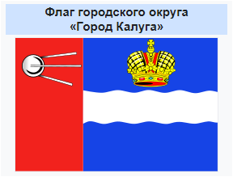
Interesting facts about the first artificial satellite of the Earth
The first artificial satellite of the Earth actively functioned in orbit for 21 days – from October 4 to October 25. He spent 92 days in space, making 1440 revolutions around the Earth
2. The image of «Sputnik-1» was placed on the flag Kaluga as the cradle of cosmonautics
3. After the launch of the first IZT, the Russian word «sputnik» entered many languages of the world.

Slide 7
ThaNK you For watching

